Slide 1
Robotics Camp-2022
Session: 01, Class: 2nd

Slide 2
Robotics Camp-2022
Fundamental theme of Automation
Input
Process
Output

Slide 3
Robotics Camp-2022
Input Devices
OUTPUT DEVICES​
Temperature Sensor
Motion Sensor
Light Dependent Resistor (LDR)
Fire/ Flame Sensor
Water Sensor
Obstacle or IR Proximity Sensor
Motor
Lamp
Fan
Buzzer
Pump

Slide 4
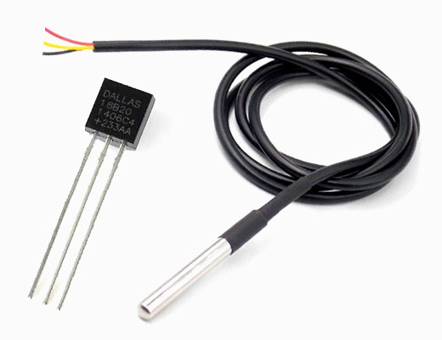
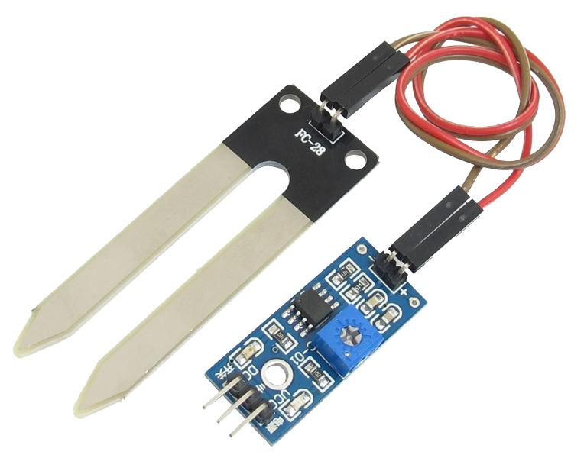
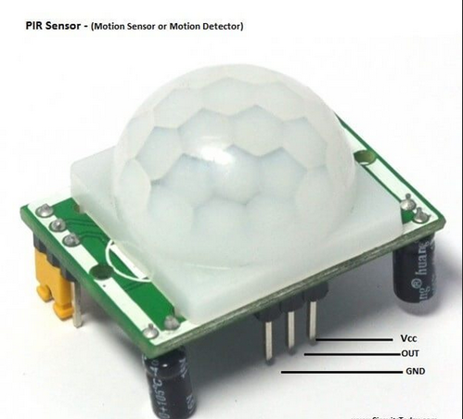
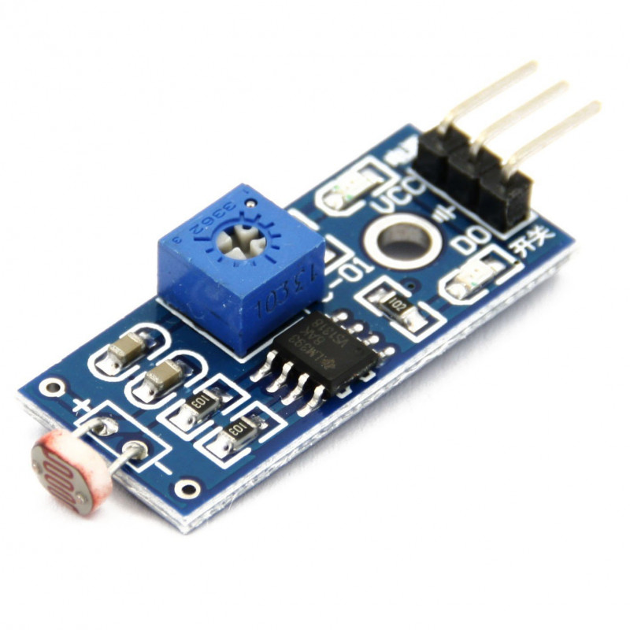
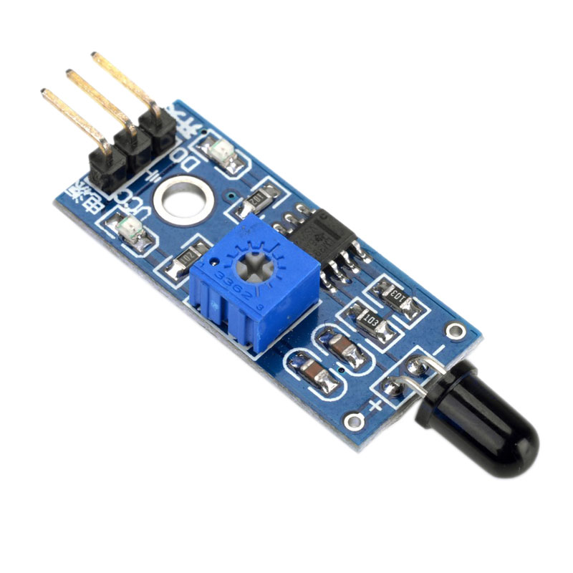
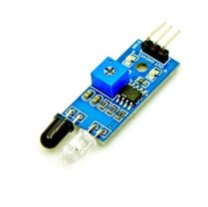
Temperature Sensor
Moisture/Water Sensor
Motion Sensor
Light Sensor
Fire Sensor
Obstacle Sensor

Slide 5
Robotics Camp-2022
Robotics & Automation
Project Idea Generation

Slide 6
Robotics Camp-2022
Input Devices
OUTPUT DEVICES​
Temperature Sensor
Motion Sensor
Light Sensor
Fire/ Flame Sensor
Water Sensor
Obstacle Sensor
Motor
Fan
Buzzer
Pump
Lamp

Slide 7
Robotics Camp-2022
Motion Sensor + Lamp
Automatic Indoor Lamp
If, Motion Sensor High - Lamp on
Else - Lamp off.

Slide 8
Robotics Camp-2022
Input Devices
OUTPUT DEVICES​
Temperature Sensor
Motion Sensor
Light Sensor
Fire/ Flame Sensor
Water Sensor
Obstacle Sensor
Motor
Fan
Buzzer
Pump
Lamp

Slide 9
Robotics Camp-2022
Motion Sensor + Buzzer
Automatic Thief Detector
If, Motion Sensor High - Buzzer on
Else - Buzzer off.

Slide 10
Robotics Camp-2022
Input Devices
OUTPUT DEVICES​
Temperature Sensor
Motion Sensor
Light Sensor
Fire/ Flame Sensor
Water Sensor
Obstacle Sensor
Motor
Fan
Buzzer
Pump
Lamp

Slide 11
Robotics Camp-2022
Light Sensor + Lamp
Automatic Street Lamp
If, Light Sensor High – Lamp off
Else – Lamp on.

Slide 12
Tasks
Generate 10 Project Ideas.
Upload It on Facebook Community Group within Tomorrow, 7:00 PM

Slide 13
Sample Post
Robotics Camp-2022 Batch-22101 Assignment-02 Full Name & ID Number
Idea 01: Motion Sensor + Lamp, Automatic Indoor Lamp If, Motion Sensor High - Lamp on
Else - Lamp off.
Idea 02: ………
Idea 03:………

Slide 14
THANK YOU

Slide 15

Sukanta Sharma Shiplob Chief Coordinator, Roboment

Slide 16
Notice: Quiz
Batch 22101 students
Equipment Collect with Security Fee
Three Set Question Paper (School, College, University)
Start from: January 18th, 2022 Right 9:00pm
Duration: 30min, Marks: 30
Pattern: MCQ, Short Questions
Syllabus: Camp Class 01 & Class 02 (Lecture & Assignment, Basic IQ)
Lab equipment box for first 200winners with BDT 2510 security money.
Have to pay within January 19th, 2022 to January 20th, 2022

